Slide 1
Discrete Random Variables

Slide 2

Probability mass function
The probability mass function (pmf) of X assigns a positive probability to each value x.
The probabilities sum up to 1:
The pmf can be described by a probability table
X | x₁ | x₂ | ... | x_{M}
P(X=x) | p(x₁) | p(x₂) | ... | p(x_{M})

Slide 3

Cumulative distribution function
The probability that a random variable takes values smaller or equal to x is called cumulative probability.
The function F(x): Ω → [0,1] assigning to all possible values of X their cumulative probability is called cumulative distribution function (cdf).

Slide 4
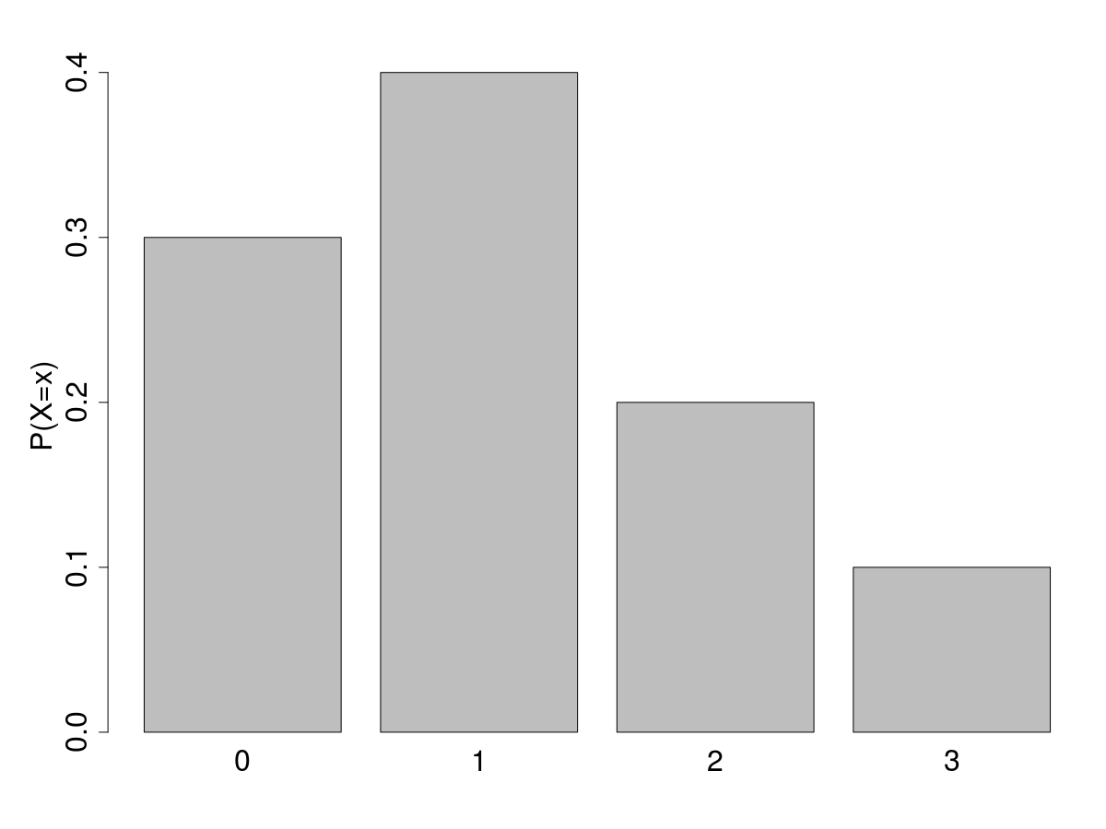
Cumulative mass function
The figure represents the probability distribution of X.
Write the PMF and CMF of X.
X | PMF: P(X=x) | CMF: P(X<=x)
0 | 0.3 | 0.3
1 | 0.4 | 0.7
2 | 0.2 | 0.9
3 | 0.1 | 1

Slide 5

Cumulative distribution function
The CMF is meaningful only for ordinal random variables
F(x) is a non decreasing function

Slide 6
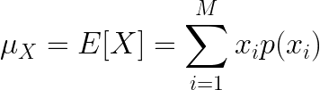
Expected value
of a discrete random variable
As for population variables, we are often interested in providing a summary measure of the central position and spread (or variability) of a random variable
We measure the central position by the expected value (or expectation or mean), which is a weighted average of the possible outcomes

Slide 7
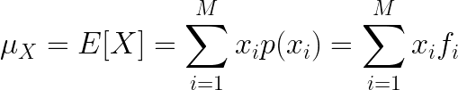
Expected value of X
Example
Randomly sampling from a population
We are interested in the expected value of attribute X of the randomly sampled individual.
The probability of each possible value x_{i} of rv X is given by its frequency f_{i}
Then,
which is equal to the population mean value of X.

Slide 8
Expected value
of a discrete random variable
In a game of cards you win $1 if you draw a heart, $5 if you draw an ace (including the ace of hearts), $10 if you draw the king of spades and nothing for any other card you draw. Write the probability model for your winnings, and calculate your expected winning.

Slide 9
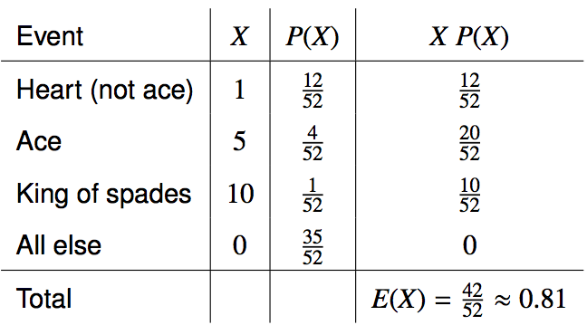
Expected value
of a discrete random variable
In a game of cards you win $1 if you draw a heart, $5 if you draw an ace (including the ace of hearts), $10 if you draw the king of spades and nothing for any other card you draw. Write the probability model for your winnings, and calculate your expected winning.

Slide 10
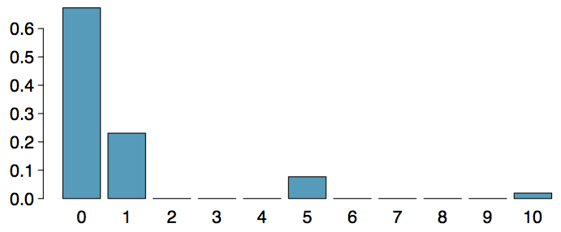
Expected value
of a discrete random variable (cont.)
Below is a visual representation of the probability distribution of winnings from this game:

Slide 11
Practice
A casino game costs $5 to play. If you draw first a red card, then you get to draw a second card. If the second card is the ace of hearts, you win $500. If not, you don't win anything, i.e. lose your $5. What is your expected profits (or losses) from playing this game? Remember: profit (or loss) = winnings - cost.
(a) a loss of 10¢ (c) a loss of 30¢
(b) a loss of 25¢ (d) a profit of 5¢

Slide 12
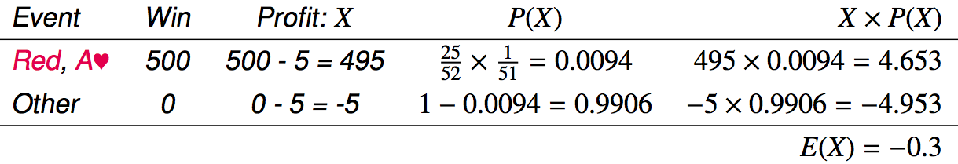
Practice
A casino game costs $5 to play. If you draw first a red card, then you get to draw a second card. If the second card is the ace of hearts, you win $500. If not, you don't win anything, i.e. lose your $5. What is your expected profits (or losses) from playing this game? Remember: profit (or loss) = winnings - cost.
(a) a loss of 10¢ (c) a loss of 30¢
(b) a loss of 25¢ (d) a profit of 5¢

Slide 13
Expected value of a function of X
Sometimes we are interested in a function g(X) of X.
Example: Assume to play a second round of the game of card above, where the gain for each draw is squared. What is the expected winning now?
E[X²] = E[Y]
= 0・35/52 + 1・12/52 + 25・4/52 + 100・1/52
= 0²・35/52 + 1²・12/52 + 5²・4/52 + 10²・1/52
= 212/52
X | P(X) | Y = X²
0 | 35/52 | 0
1 | 12/52 | 1
5 | 4/52 | 25
10 | 1/52 | 100

Slide 14

Expected value of a function of X
In general, it holds:

Slide 15
Expected value of a function of X
The yearly maintenance cost of machine A is given by g(X) = 100X where X is a rv representing the number of faults per year. What is the expected yearly maintenance cost for a machine with the distribution of yearly faults given in the table below?
x | p(x)
0 | 0.85
1 | 0.1
2 | 0.05

Slide 16
Properties of E[X]
If a ≤ x ≤ b then a ≤ E[x] ≤ b The expected value of a RV cannot be larger than its maximum value nor smaller than if minimum.
E[c] = c The expected value of a constant is the constant itself
Linearity of expectation: E[aX+b] = aE[X]+b The expected value of a linear transformation of X is equal to the same linear transformation applied to E[X].

Slide 17
Linear combinations
A linear combination of random variables X and Y is given by
aX + bY
where a and b are some fixed numbers.

Slide 18

Linear combinations
A linear combination of random variables X and Y is given by
aX + bY
where a and b are some fixed numbers.
The average value of a linear combination of random variables is given by
E(aX + bY) = a⋅E(X) + b⋅E(Y)
In general,

Slide 19
Calculating the expectation
of a linear combination
On average you take 10 minutes for each statistics homework problem and 15 minutes for each chemistry homework problem. This week you have 5 statistics and 4 chemistry homework problems assigned. What is the total time you expect to spend on statistics and physics homework for the week?

Slide 20
Calculating the expectation
of a linear combination
On average you take 10 minutes for each statistics homework problem and 15 minutes for each chemistry homework problem. This week you have 5 statistics and 4 chemistry homework problems assigned. What is the total time you expect to spend on statistics and physics homework for the week?
TOTAL TIME = S₁+S₂+S₃+S₄+S₅+C₁+C₂+C₃+C₄
E[TOTAL TIME] = E[S₁] + E[S₂] + … + E[C₁] + ...
= 5E[S] + 4 E[C] = 5・10 + 4・15 = 100
Note: The total time is NOT 5S+4C! This will make a difference in the computation of the variance

Slide 21
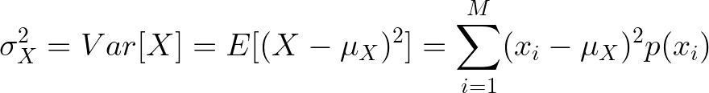


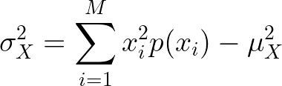
Variability
We measure the variability of a random variable by its variance and standard deviation.
It can be proven that
Then, the variance can be computed using the simpler expression

Slide 22
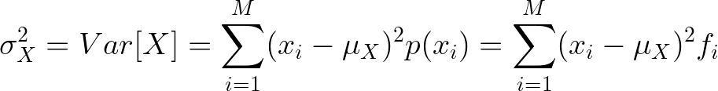
Variance of X
Example
Randomly sampling from a population
As for the expected value, the variance of rv X describing an attribute of the randomly sampled individual is equal to the population variance of that attribute

Slide 23
Variability of
a discrete random variable
For the previous card game example, how much would you expect the winnings to vary from game to game?

Slide 24
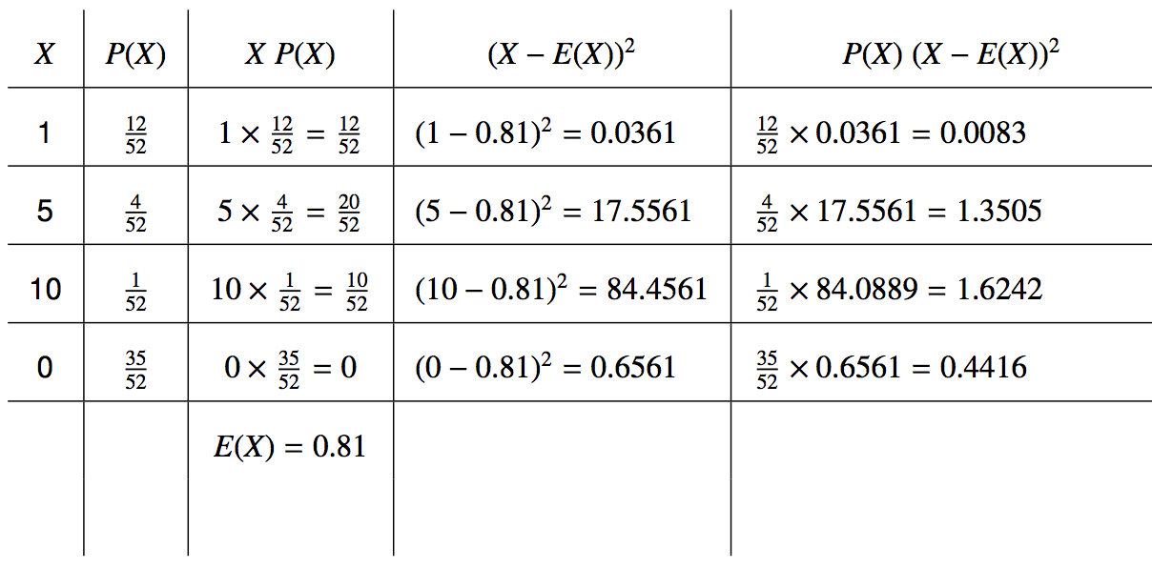
Variability of
a discrete random variable
For the previous card game example, how much would you expect the winnings to vary from game to game?

Slide 25


Variability of
a discrete random variable
For the previous card game example, how much would you expect the winnings to vary from game to game?

Slide 26

Properties of the variance
Variance of a constant: V[b] = 0
Variance of a linear function: V[aX+b] = a²V[X]
The variance of a linear combination of two independent random variables is calculated as:

Slide 27
Linear combinations
The standard deviation of the time you take for each problem of statistics is 1.5 minutes, and it is 2 minutes for each chemistry problem. What is the standard deviation of the time you expect to spend on statistics and chemistry homework for the week if you have 5 statistics and 4 chemistry homework problems assigned?

Slide 28
Linear combinations
The standard deviation of the time you take for each problem of statistics is 1.5 minutes, and it is 2 minutes for each chemistry problem. What is the standard deviation of the time you expect to spend on statistics and chemistry homework for the week if you have 5 statistics and 4 chemistry homework problems assigned?
V[S₁+S₂+S₃+S₄+S₅+C₁+C₂+C₃+C₄]=
= V[S₁]+V[S₂]+V[S₃]+V[S₄]+V[S₅]+V[C₁]+V[C₂]+V[C₃]+V[C₄]
= 5V[S]+4V[C]
= 5⋅1.5² + 4⋅2² = 27.25

